Slide 1


Ahsanullah University of Science and Technology
Department of Computer Science & Engineering
Course No : CSE 1200
Course Title : Software Development - I
Date of Submission : 29-08-2021
Submitted to : Mr. Ashek Seum
Mrs. Sharmin Rima
Submitted by : Abdullah Yusha – 200104113
Shamim Rahim Refat – 200104125
Shuvashis Sarker – 200104116

Slide 2
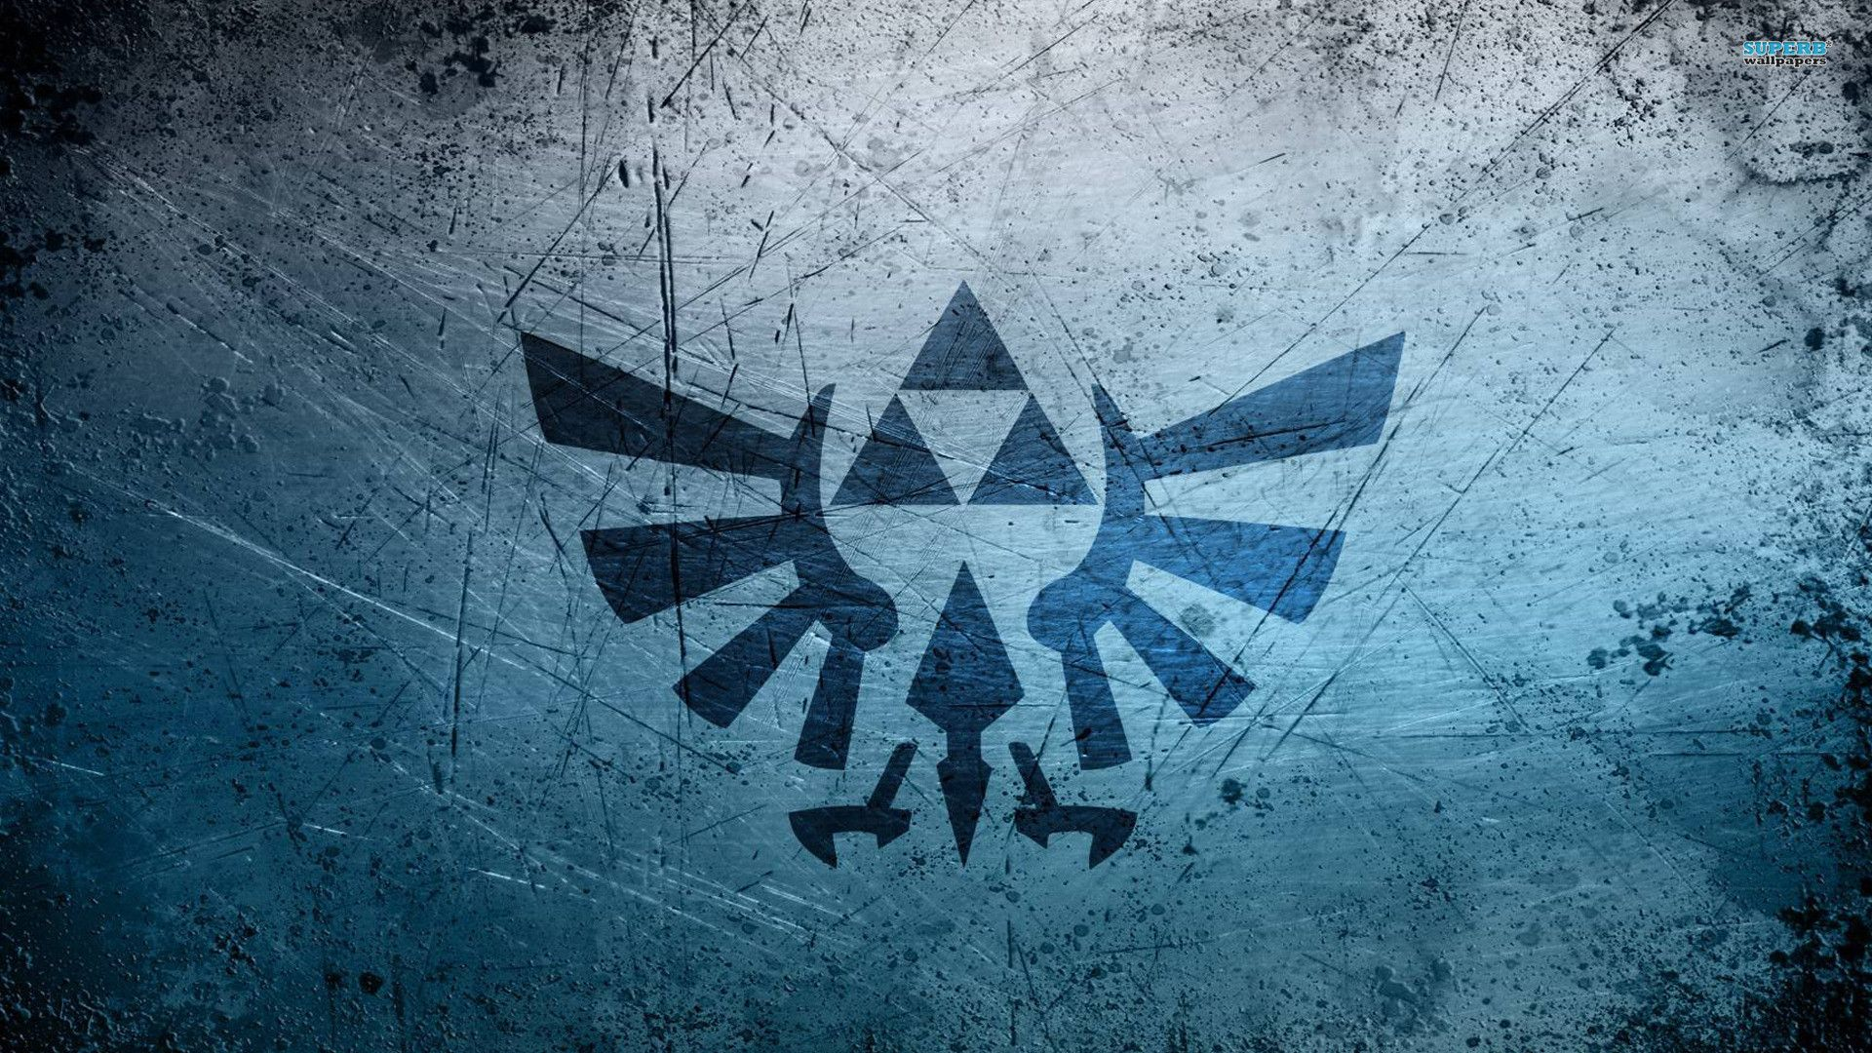
DeathStalker
A 2D Metroidvania Game.

Slide 3
TABLE OF CONTENTS
01
02
03
Game Outline
References
Unique Specifications
04
05
Core Mechanics
Progression Systems & Game Economy
01
02
03
Giving an overview of what the game is, what we are trying to accomplish (demo images are included).
Writing about what other games that are similar, what is borrowed from them, and what we are improving.
Making a bullet list of what makes our game unique.
04
05
Explaining what are the game mechanics, how they help the game achieve its goal.
Explaining how will the players keep playing the game until the end. Making a brief description of how the game economy will work (scores, lives, XP, levels etc.)

Slide 4

01
Game Outline

Slide 5

Game Outline:
DeathStalker is a 2D side-scrolling action adventure video game. This game is all about Exploration, fighting and surviving as the player ascend to the peak of a land ruled by silk and song. By creating this game we are trying to make player feel the adventure in virtual world by making a dark world to uncover , a huge map to explore. The main focus is to make the game entertaining so that the player can have plenty time to enjoy.

Slide 6
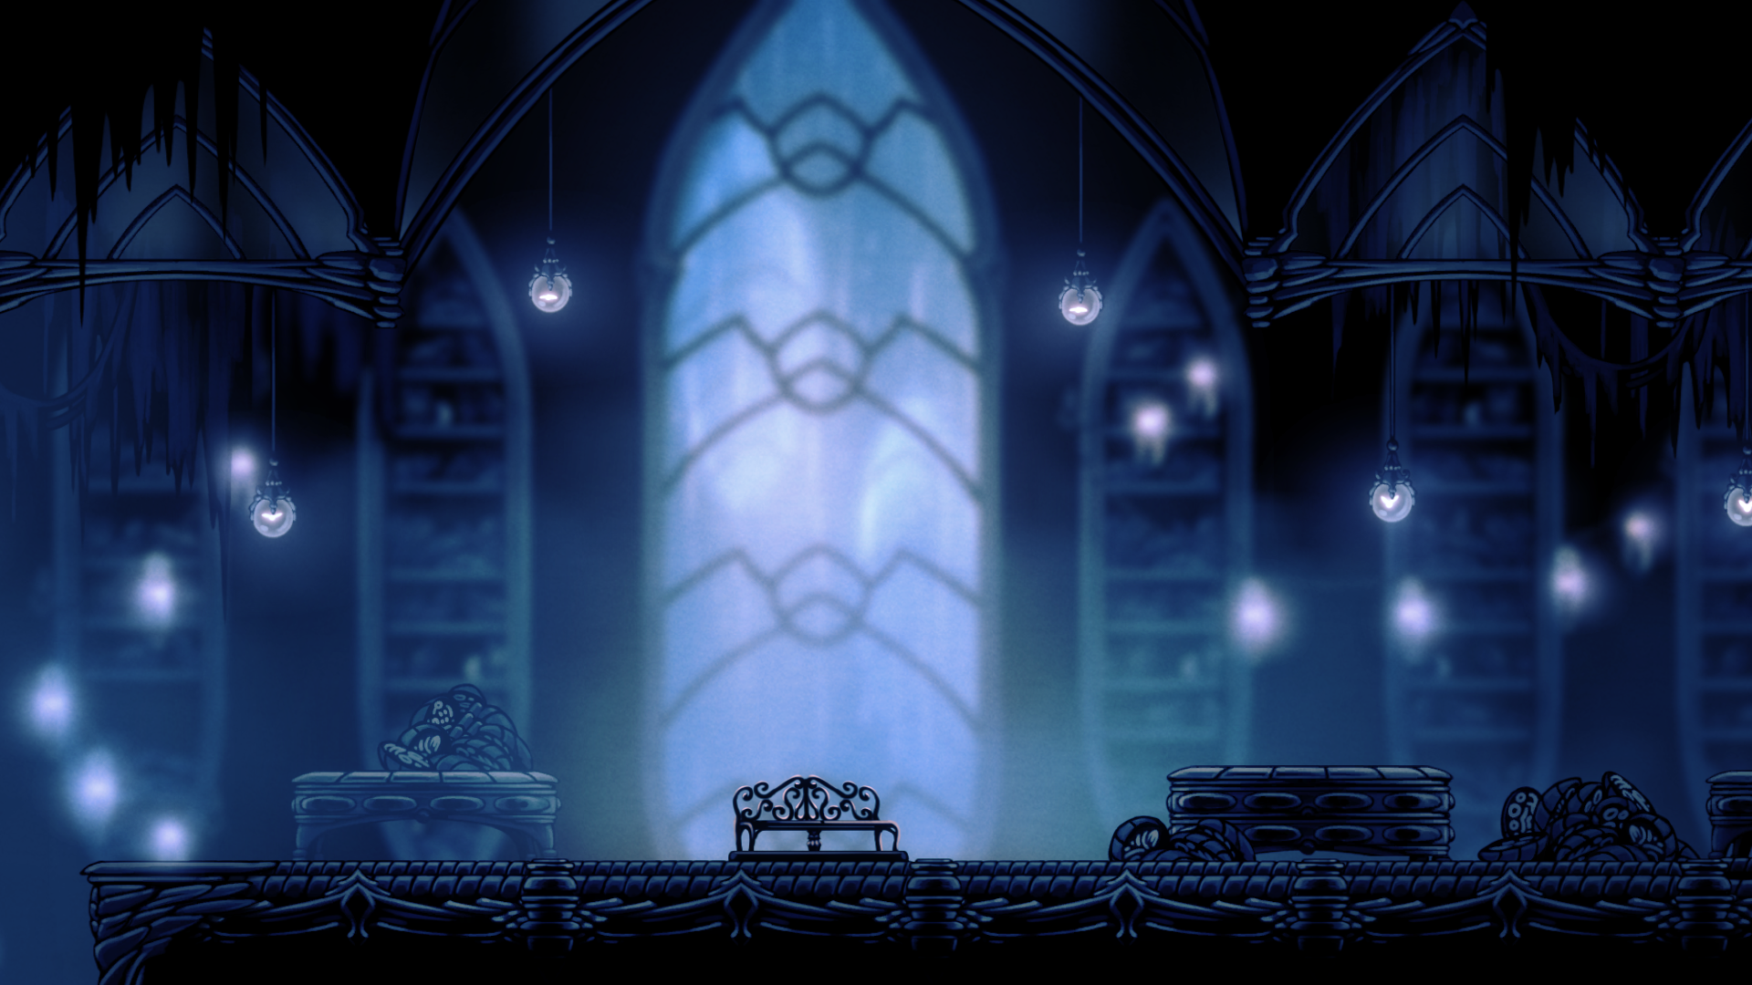
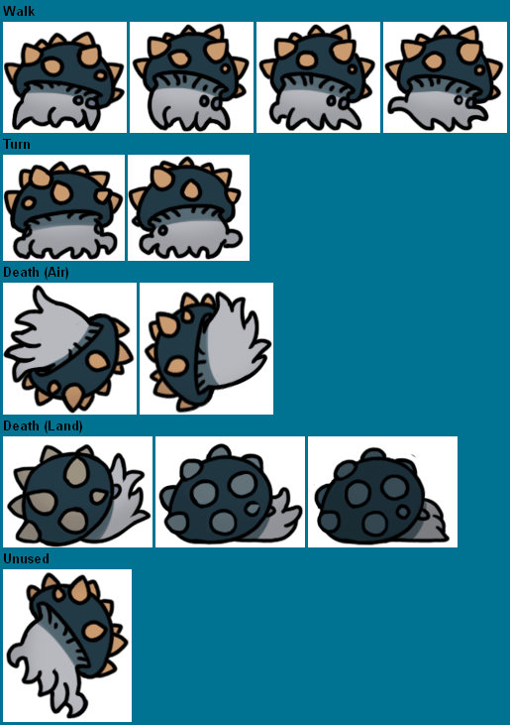
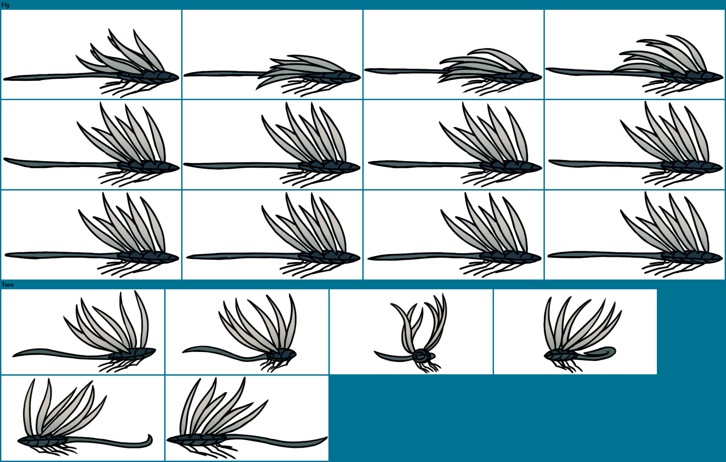
Including Demo Images!
Enemy 1 (Ground)
Enemy 2 (SKY)
Background Image !

Slide 7
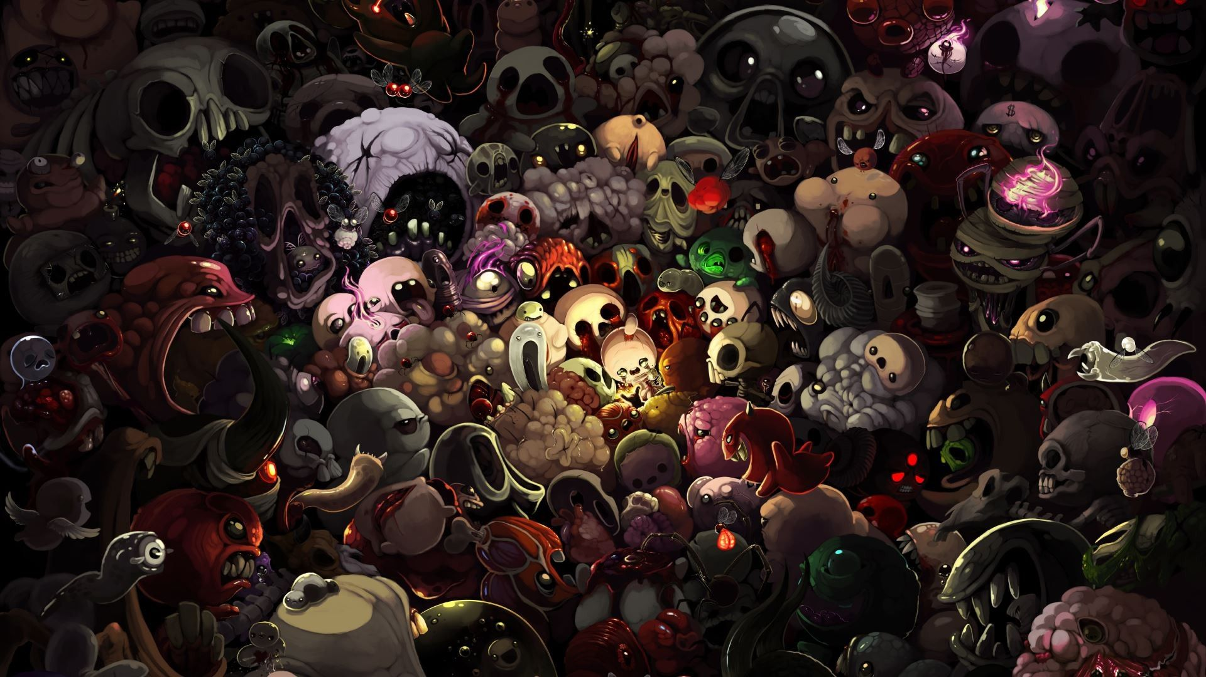
02
References

Slide 8
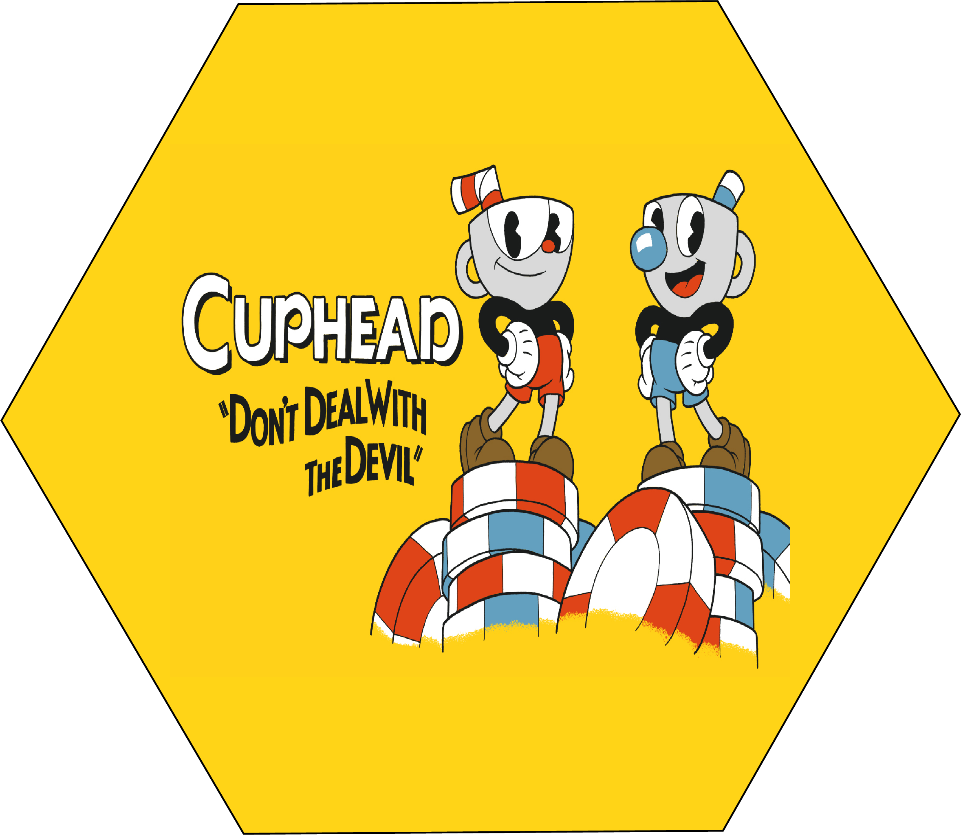
References
CupHead & DeathStalker:
The idea of side-scrolling action simulation for a 2D game is brought from Cuphead.
Both CupHead and the game we are trying to make which is DeathStalker are side-scrolling action adventure 2D platformers which means the player have to reach a single goal to complete a level.

Slide 9
What we are trying to improve from CupHead !
Gameplay
Cuphead focuses on only one thing and nails it. Hollow Knight is a more thorough experience.
Adventure
DeathStalker can give user more adventurous feel by
making a dark world to uncover and a big map to explore.
Content
Hollow Knight has way more content. Cup head probably has more replay ability.
Retreat System
In DeathStalker, user can retry instantly . In contrary, Cuphead user has to respawn at the last saved location.

Slide 10
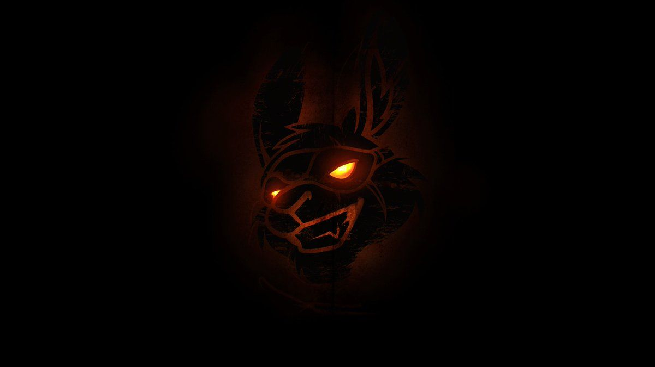
03
Unique Specifications

Slide 11
Unique Specification
Storyline
PROGRESSION
CHALLENGE
Exploration of the dark world
Walking/Jumping/killing enemies in a unique dark world allows DeathStalker to standout from other 2D games .
Follows a unique storyline where a nameless warrior uncertain of their own identity or origin wanders and explores the ruined kingdom of Hallownest to uncover its mysteries.
DeathStalker has distinct progression through certain zones, abilities, charms, and stats being unlocked or improved.
DeathStalker manages to strike the balance of casual/veteran-friendly difficulty that many games lack.

Slide 12
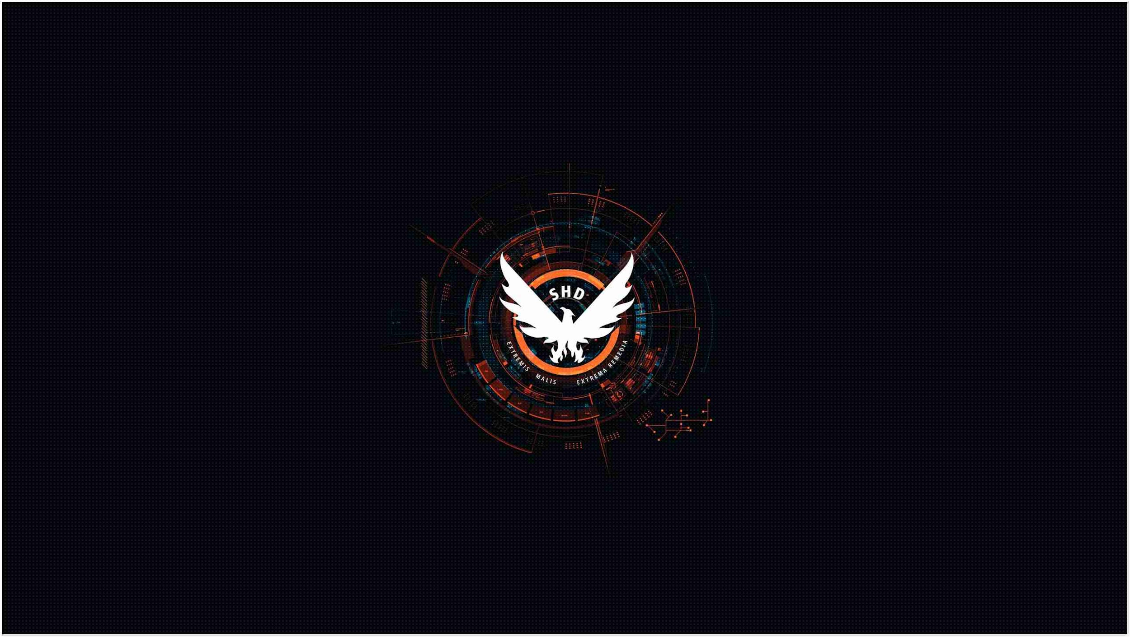
04
Core Mechanics

Slide 13

Core Mechanics
Core Mechanics :
A game’s core mechanic is the action of play: the activity players do over and over again in the game.
The Core mechanics of DeathStalker is jumping, collecting, flying, or shooting.
How the core mechanics help the game achieve its goal !
As mentioned earlier the goal of this game is exploration of the dark dungeon. By doing the repetitive but under different conditions jumping ,collecting and flying or shooting the user will explore and enjoy killing the enemies.

Slide 14

05 Progression System & Game Economy

Slide 15
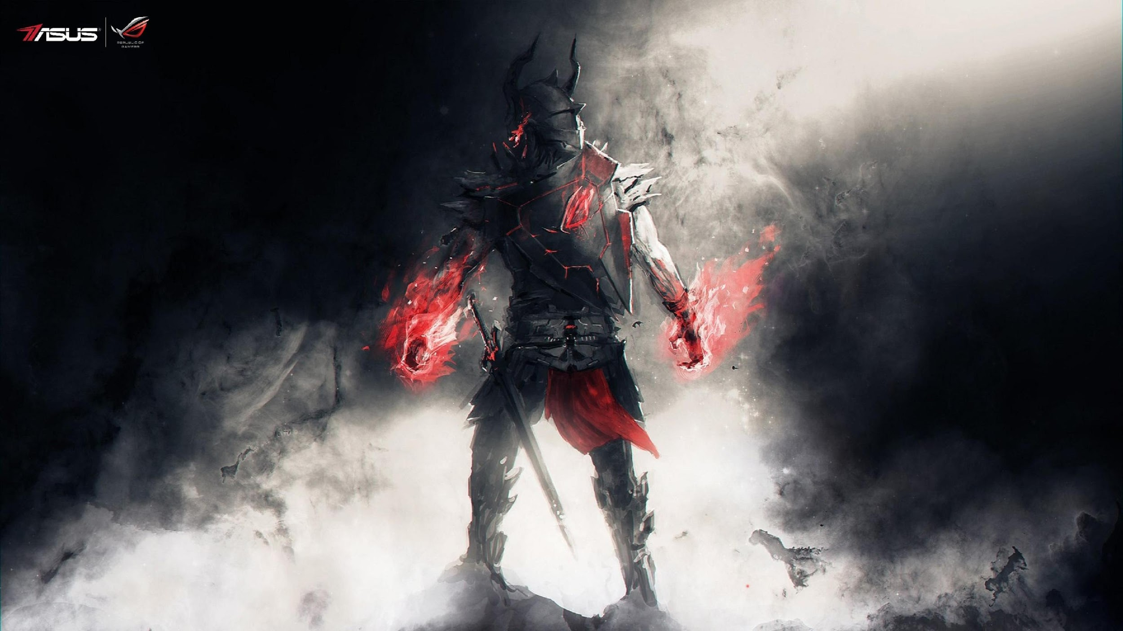
Progression System
The Players will face obstacles(like spikes, sudden void space) and enemies which they have to kill to survive. And at the end of a level ,player will face the level boss.

Slide 16
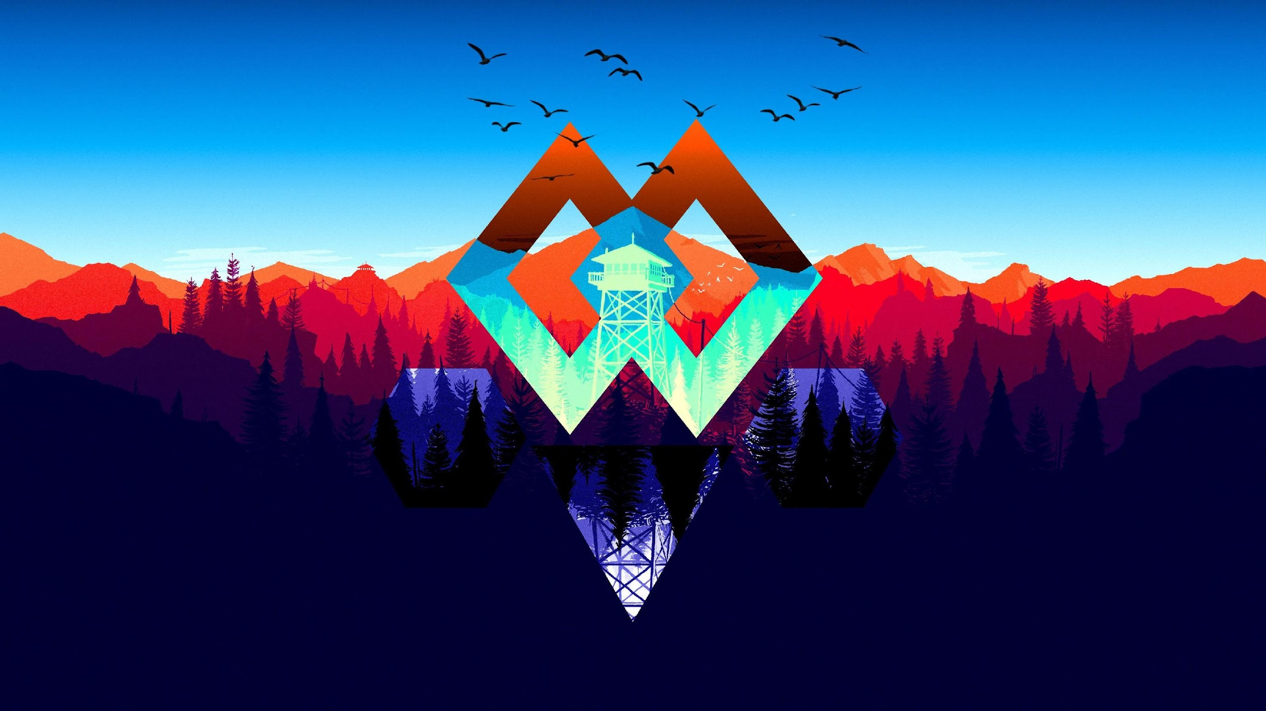
How Game Economy Works!
In a certain level, killing an enemy will increase XP.
The main character will have bench to rest which will increase XP and this XP will be used to overpower the character
After passing obstacles and killing side character enemies, player will face the final level boss . If the boss is defeated player will proceed to next level. And find the last boss(strongest one) in upcoming levels

Slide 17
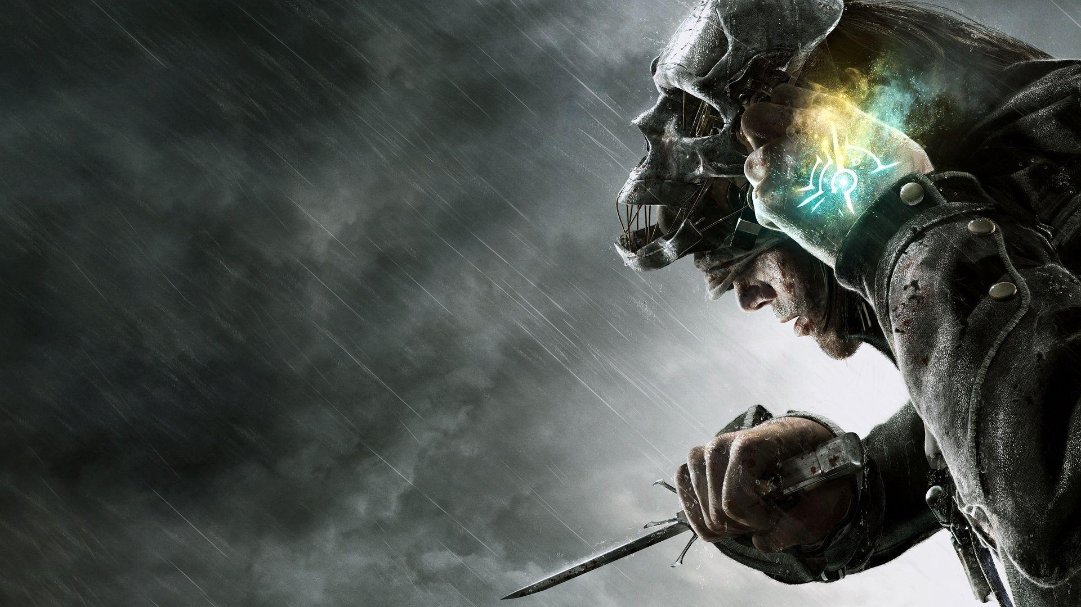
Thank You…!

